Slide 2
Entity Set
Each entity type will have a collection of entities stored in the database
Called the entity set
Entity set is the current state of the entities of that type that are stored in the database

Slide 3
ER Model Concepts
Entities and Attributes
Entities are specific objects or things in the mini-world that are represented in the database.
For example the EMPLOYEE John Smith, the Research DEPARTMENT, the ProductX PROJECT
Attributes are properties used to describe an entity.
For example an EMPLOYEE entity may have the attributes Name, SSN, Address, Sex, BirthDate
A specific entity will have a value for each of its attributes.
For example a specific employee entity may have Name='John Smith', SSN='123456789', Address ='731, Fondren, Houston, TX', Sex='M', BirthDate='09-JAN-55‘
Each attribute has a value set (or data type) associated with it – e.g. integer, string, subrange, enumerated type, …

Slide 4
Types of Attributes
Simple
Each entity has a single atomic value for the attribute. For example, SSN or Sex.
Composite
The attribute may be composed of several components. For example:
Address(Apt#, House#, Street, City, State, ZipCode, Country), or
Name(FirstName, MiddleName, LastName).
Composition may form a hierarchy where some components are themselves composite.
Multi-valued
An entity may have multiple values for that attribute. For example, Color of a CAR or PreviousDegrees of a STUDENT.
Denoted as {Color} or {PreviousDegrees}.

Slide 5
In general, composite and multi-valued attributes may be nested arbitrarily to any number of levels, although this is rare.
For example, PreviousDegrees of a STUDENT is a composite multi-valued attribute denoted by {PreviousDegrees (College, Year, Degree, Field)}
Multiple PreviousDegrees values can exist
Each has four subcomponent attributes:
College, Year, Degree, Field

Slide 6
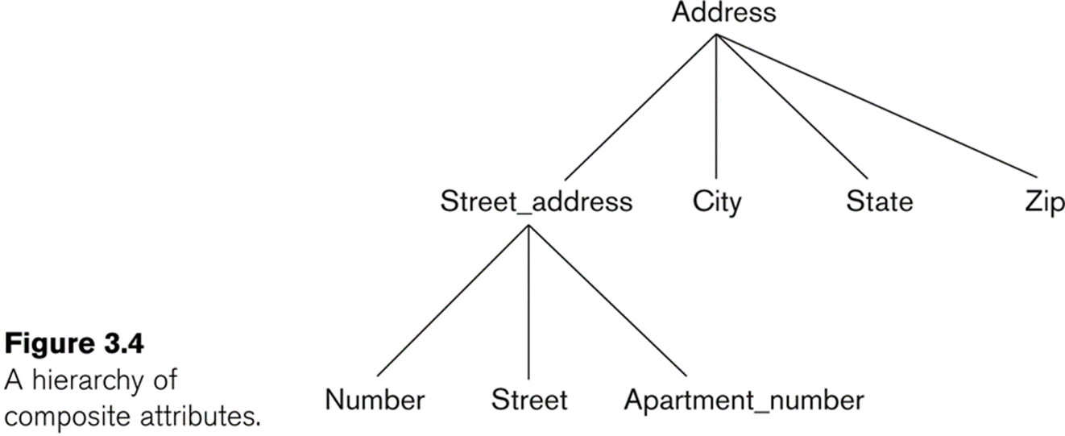

Slide 7
Keys
SuperKey-An attribute or a set of attribute is used to identity an entity
Candidate Key –Minimal Superkey
Primary Key-One of the candidate keys selected by the DBA to uniquely identify an entity

Slide 8
Entity Types and Key Attributes
A key attribute may be composite.
VehicleTagNumber is a key of the CAR entity type with components (Number, State).
An entity type may have more than one key.
The CAR entity type may have two keys:
VehicleIdentificationNumber (popularly called VIN)
VehicleTagNumber (Number, State), aka license plate number.
Each key is underlined

Slide 9
In ER diagrams, an entity type is displayed in a rectangular box
Attributes are displayed in ovals
Each attribute is connected to its entity type
Components of a composite attribute are connected to the oval representing the composite attribute
Each key attribute is underlined
Multivalued attributes displayed in double ovals

Slide 10
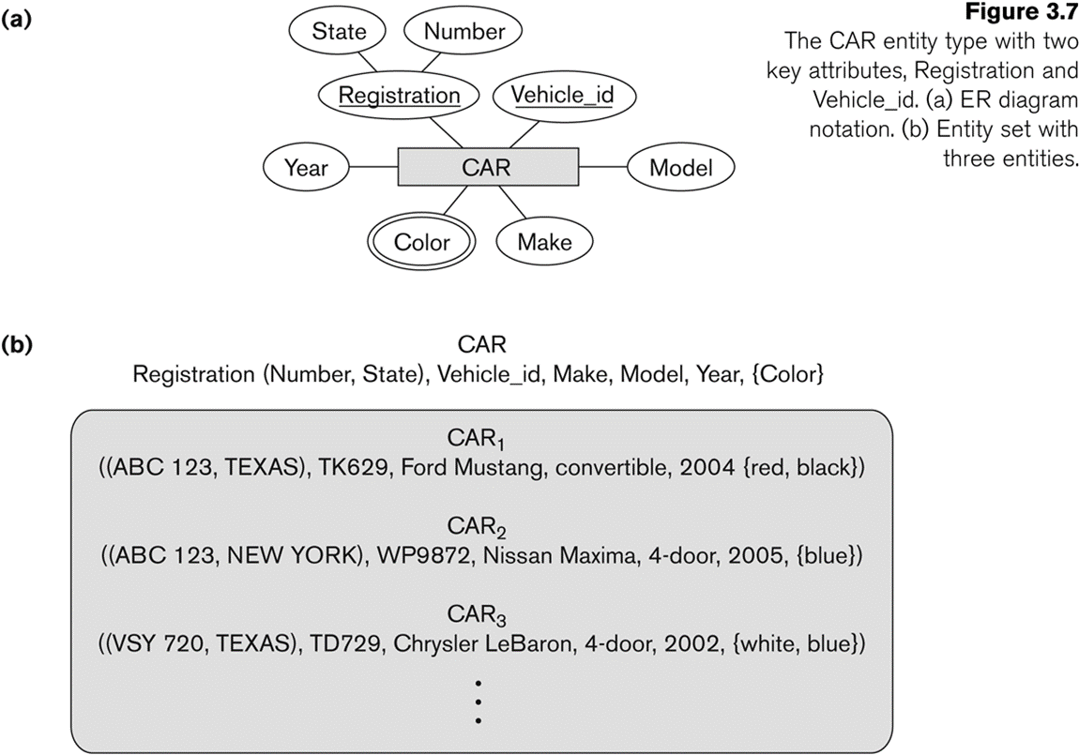

Slide 11
The company is organized into DEPARTMENTs. Each department has a name, number and an employee who manages the department. We keep track of the start date of the department manager. A department may have several locations.
Each department controls a number of PROJECTs. Each project has a unique name, unique number and is located at a single location.
We store each EMPLOYEE’s social security number, address, salary, sex, and birthdate.
Each employee works for one department but may work on several projects.
We keep track of the number of hours per week that an employee currently works on each project.
We also keep track of the direct supervisor of each employee.

Slide 12
Each employee may have a number of DEPENDENTs.
For each dependent, we keep track of their name, sex, birthdate, and relationship to the employee

Slide 13
